Slide 1


Constraining the primordial power spectrum using minihalos
Sten Delos (UNC-Chapel Hill)
Adrienne Erickcek (UNC-Chapel Hill)
Avery Bailey (Princeton University, UNC-Chapel Hill)
Marcelo Alvarez (UC Berkeley)

Slide 2
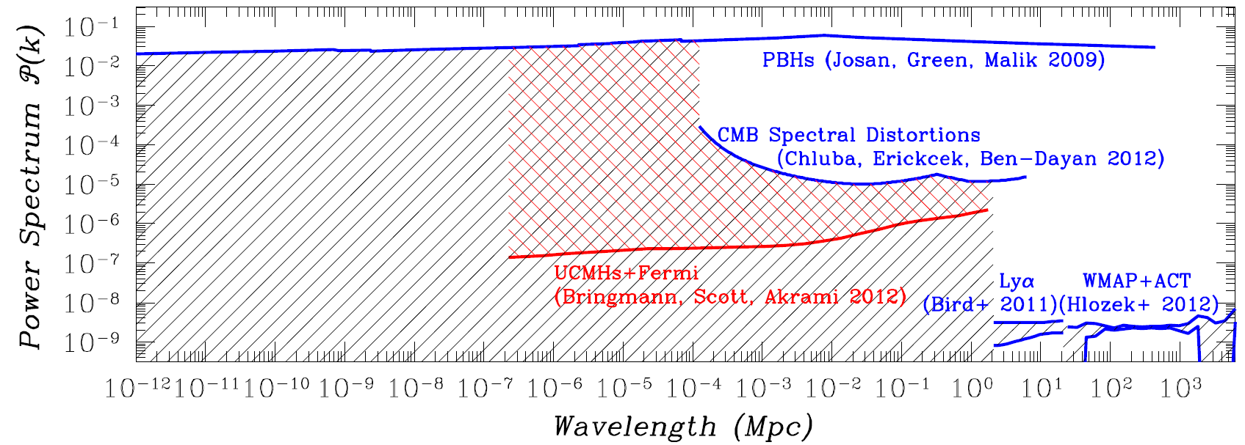
The primordial power spectrum

Slide 3
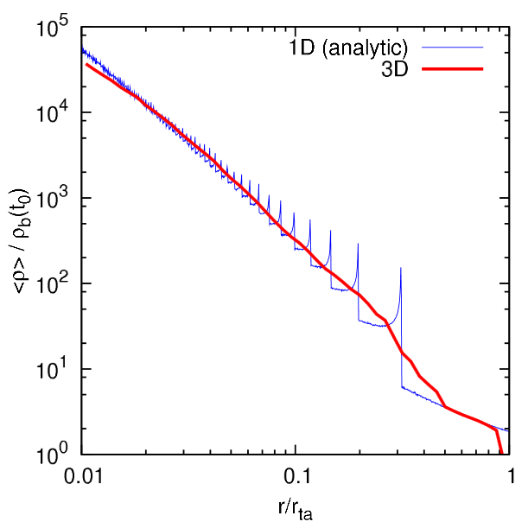
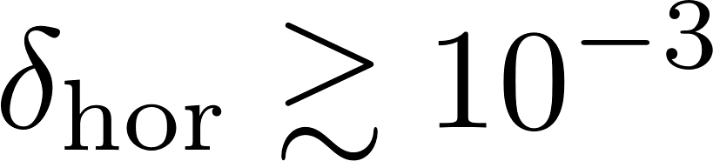
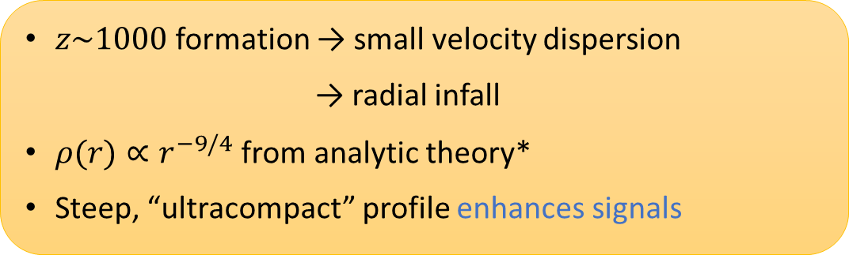
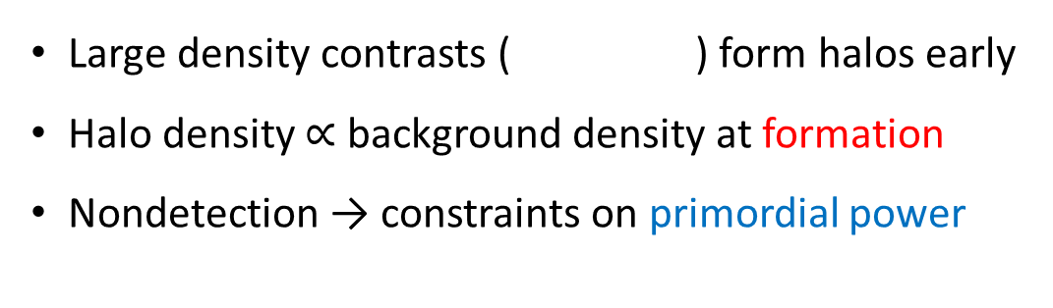
Ultracompact minihalos
Large density contrasts ( ) form halos early
Halo density $∝$ background density at formation
Nondetection → constraints on primordial power
analytic
$z\sim 1000$formation → small velocity dispersion
→ radial infall
$ρ(r)∝r^{−9/4}$ from analytic theory*
Steep, “ultracompact” profile enhances signals
idealized sim
Vogelsberger, White, Mohayaee, Springel 2009
*Fillmore & Goldreich 1984, Bertschinger 1985

Slide 4
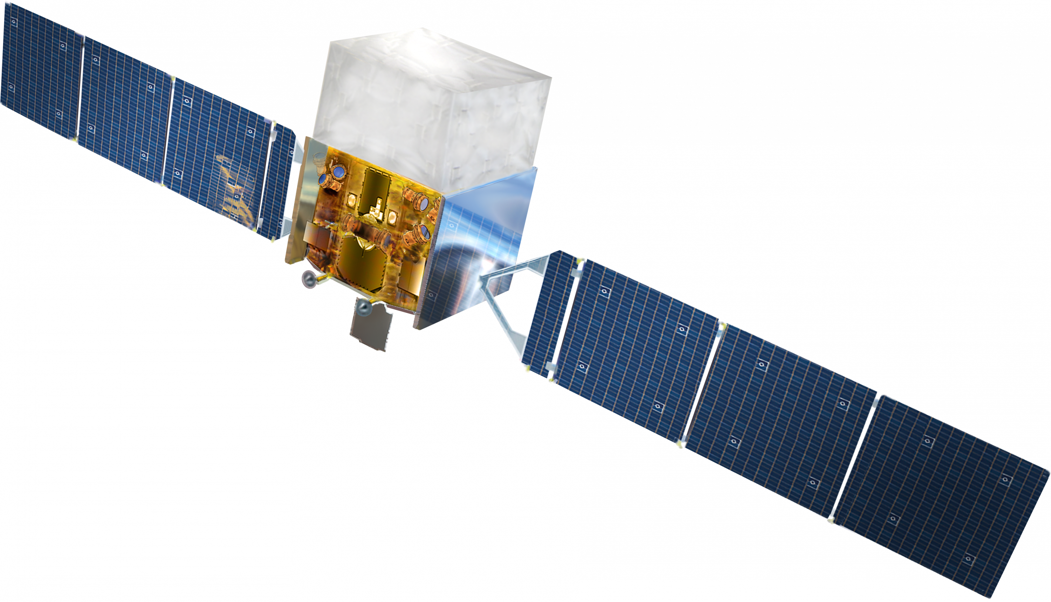
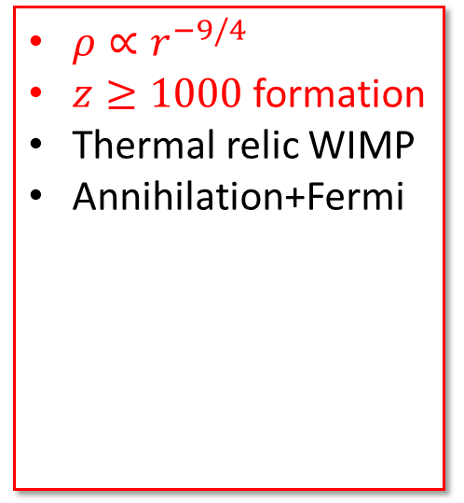
The primordial power spectrum
$ρ∝r^{−9/4}$
$z≥1000$ formation
Thermal relic WIMP
Annihilation+Fermi

Slide 5
Ultracompact minihalos
Large density contrasts ( ) form halos early
Halo density $∝$ background density at formation
Nondetection → constraints on primordial power
Analytic theory assumes
Spherical symmetry
Radial motion
Self-similarity
Realistic infall is more complicated!
analytic
$z\sim 1000$formation → small velocity dispersion
→ radial infall
$ρ(r)∝r^{−9/4}$ from analytic theory*
Steep, “ultracompact” profile enhances signals
idealized sim
Vogelsberger, White, Mohayaee, Springel 2009
*Fillmore & Goldreich 1984, Bertschinger 1985

Slide 6
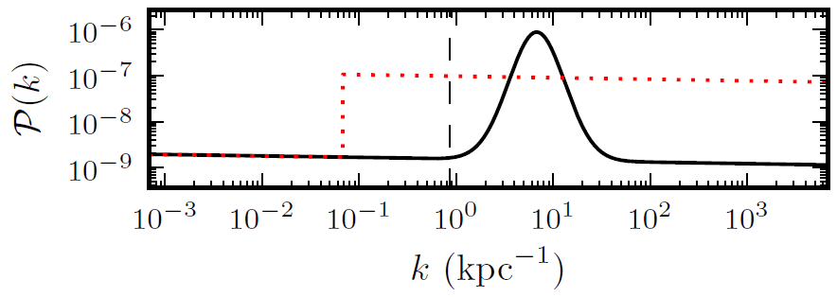
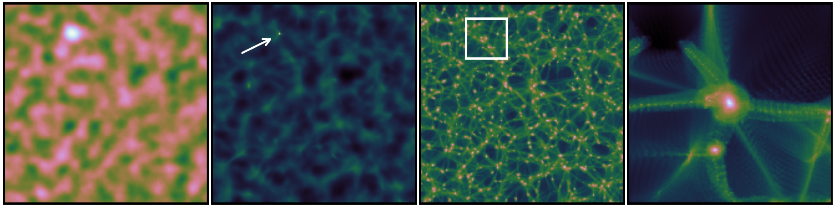
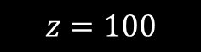
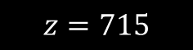
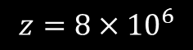
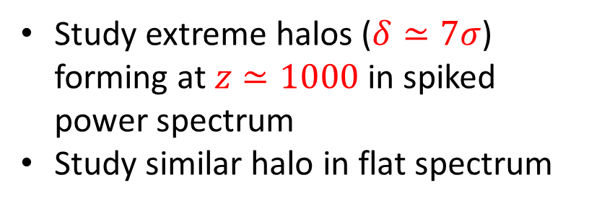

Simulating a natural formation scenario
Study extreme halos ($δ≃7σ$) forming at $z≃1000$ in spiked power spectrum
Study similar halo in flat spectrum
Delos+ 2018
(spiked power spectrum)
$$z=8×{10}^{6}$$
$$z=715$$
$$z=100$$
$$z=100$$
Delos+ 2018

Slide 7
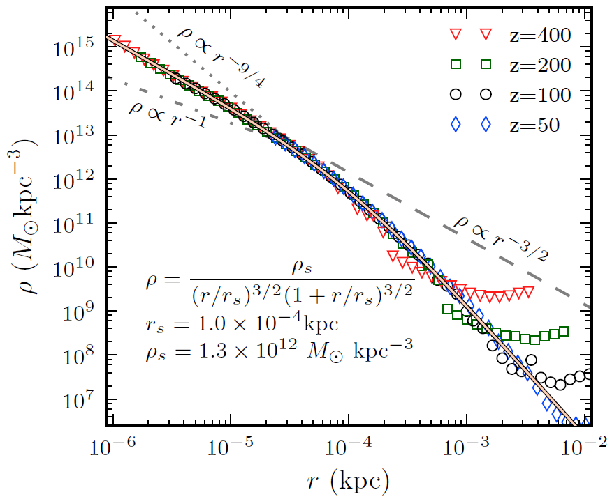
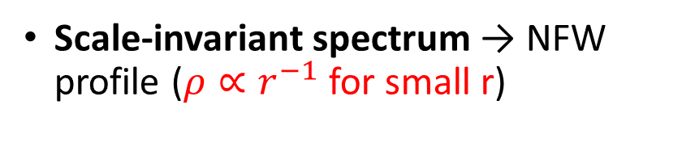
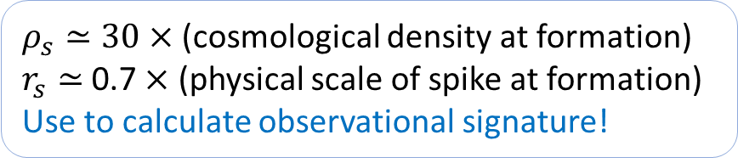
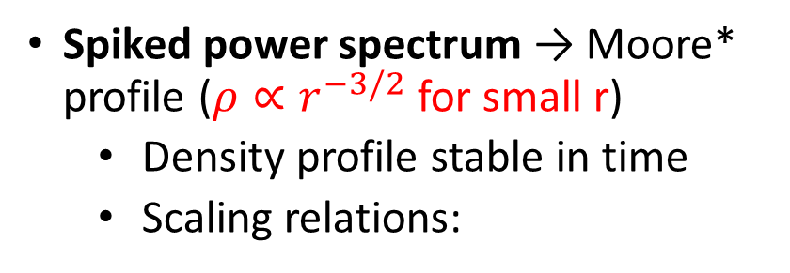
Density profile
Spiked power spectrum → Moore* profile ($ρ∝r^{−3/2}$ for small r)
Density profile stable in time
Scaling relations:
$ρ_{s}≃30×$ (cosmological density at formation)
$r_{s}≃$ 0.7 $×$ (physical scale of spike at formation)
Use to calculate observational signature!
Scale-invariant spectrum → NFW profile ($ρ∝r^{−1}$ for small r)
(physical coordinates)
Delos+ 2018
*Similar to the form in Moore, Quinn, Governato, Stadel, Lake 1999

Slide 8
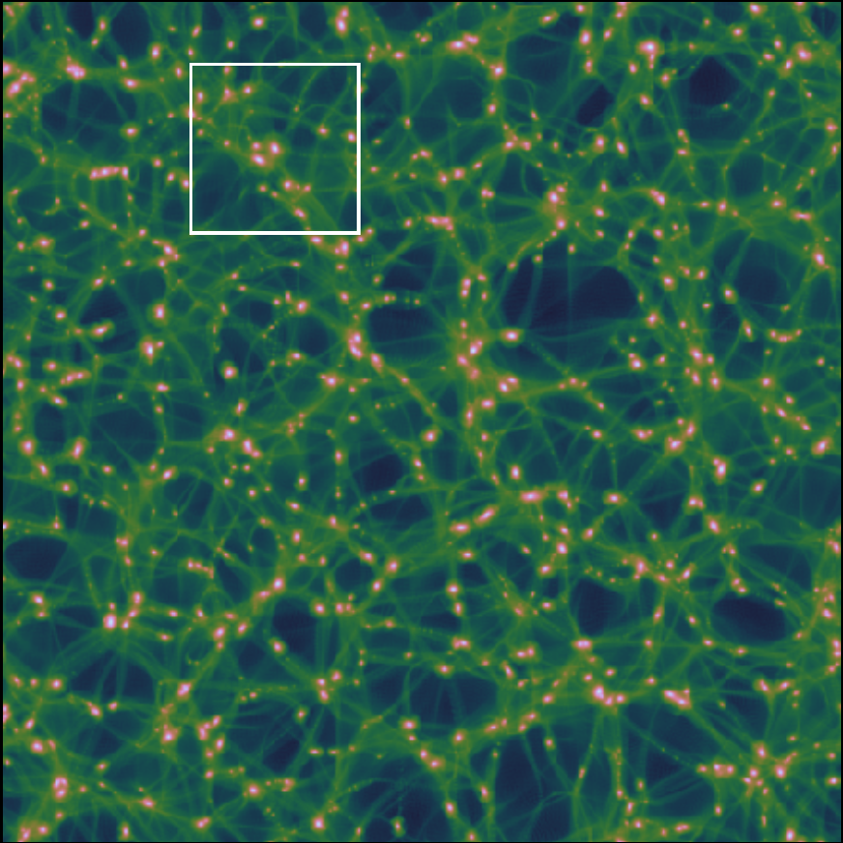
Consequences
UCMHs have Moore or NFW profiles
Pure power law requires special initial conditions
Weaker observational signals
Many more halos
Delos+ 2018

Slide 9
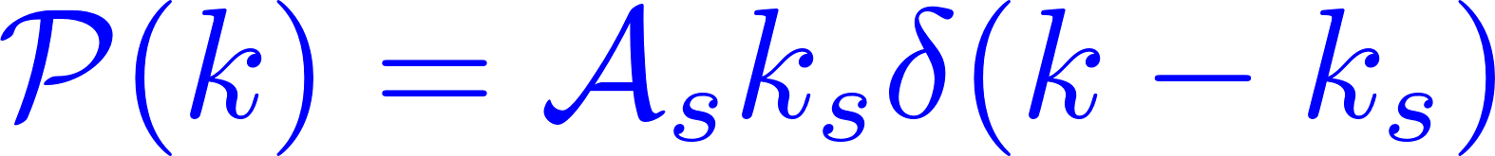
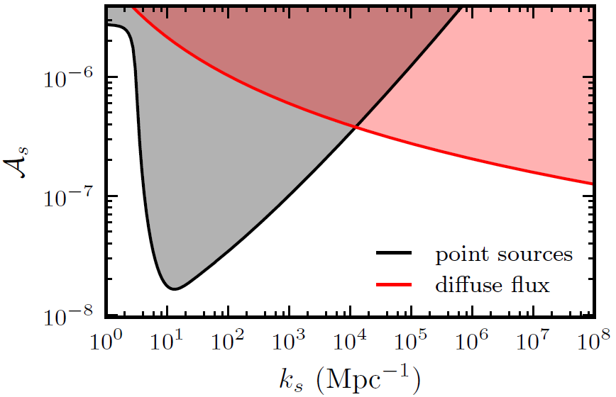
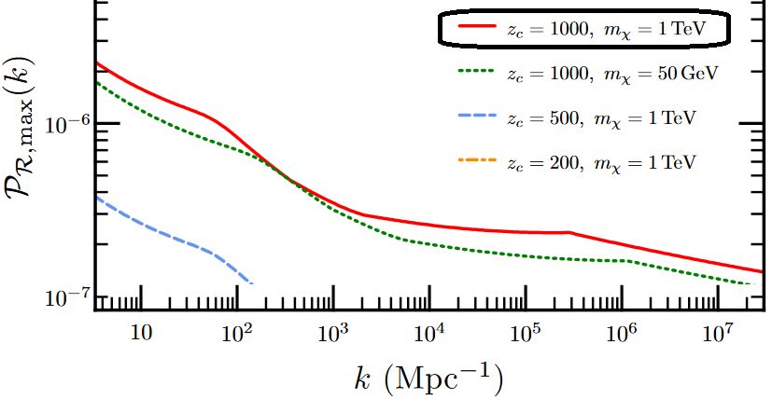
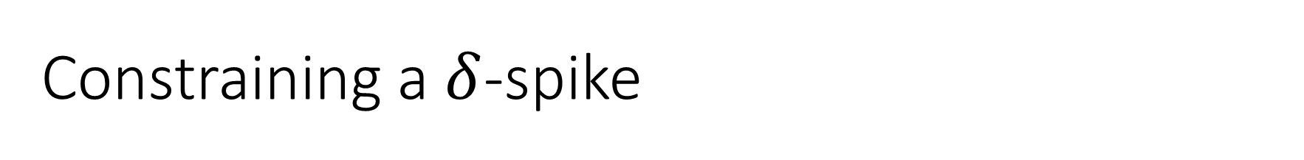
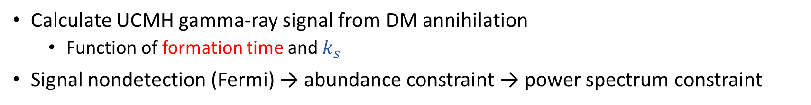
Constraining a $δ$-spike
Calculate UCMH gamma-ray signal from DM annihilation
Function of formation time and $k_{s}$
Signal nondetection (Fermi) → abundance constraint → power spectrum constraint
Bringmann, Scott, Akrami 2012
Old constraint for comparison
New constraint is generally stronger for narrow spikes!
(intragalactic sources only, same DM model)

Slide 10
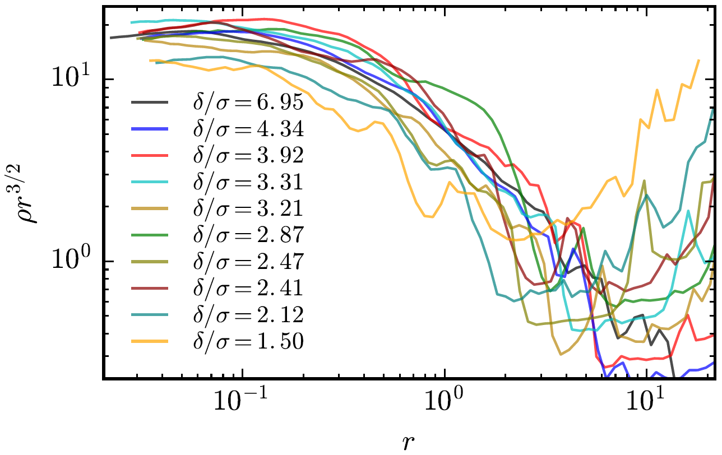
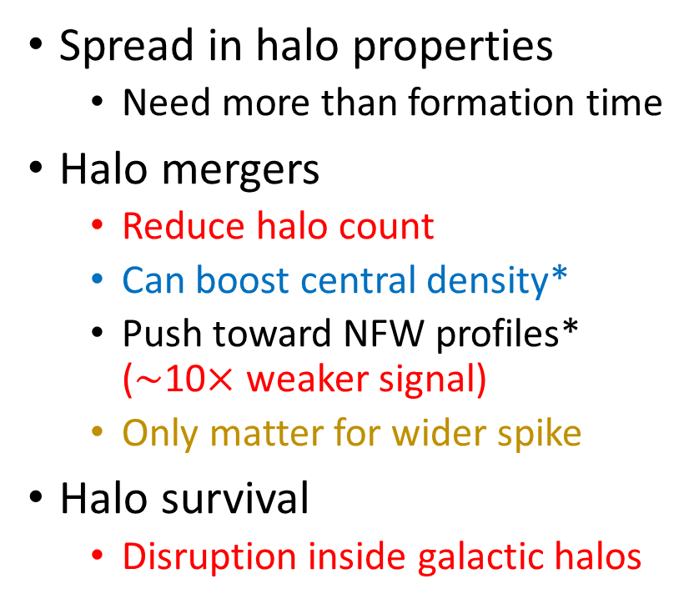
Complications
Spread in halo properties
Need more than formation time
Halo mergers
Reduce halo count
Can boost central density*
Push toward NFW profiles* ($∼$10$×$ weaker signal)
Only matter for wider spike
Halo survival
Disruption inside galactic halos
Scaled to formation time
*Ogiya, Nagai, Ishiyama 2016

Slide 11
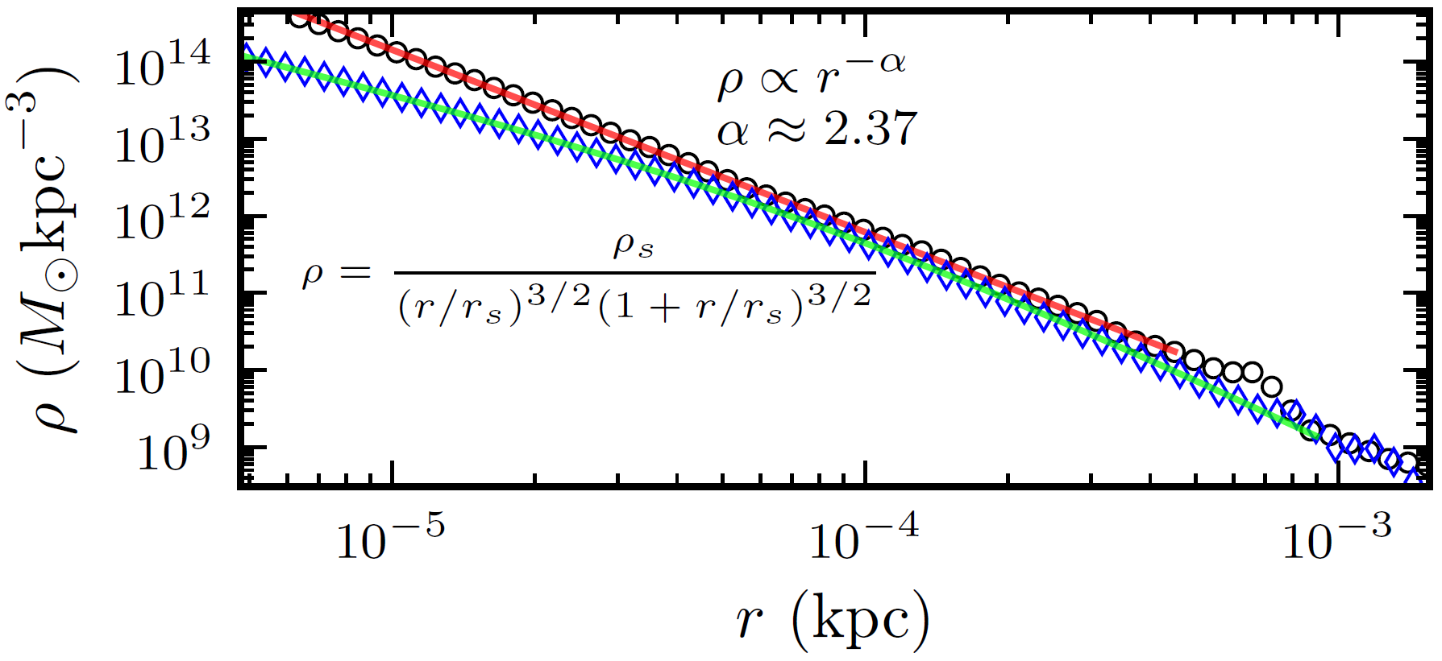
Summary
UCMH density profiles are shallower than previously assumed
New theory can account for all halos instead of just the rarest
Crude calculations suggest corrected UCMHs may possess more constraining power
Work is still needed to fully account for halo statistics and evolution
Pure power law
Moore profile
Further detail:
Phys. Rev. D 97, 041303(R) [arXiv:1712.05421] and forthcoming work

Slide 12
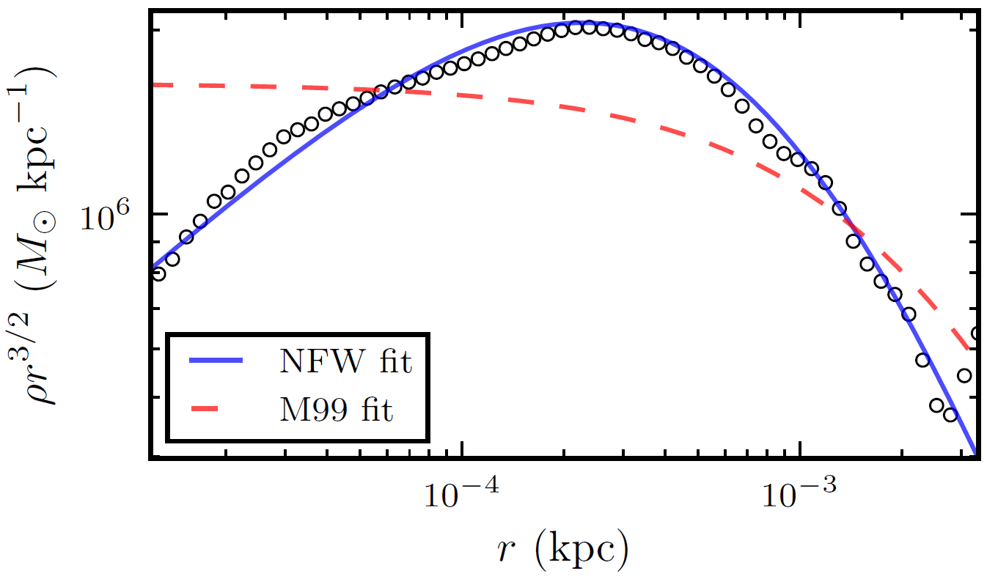
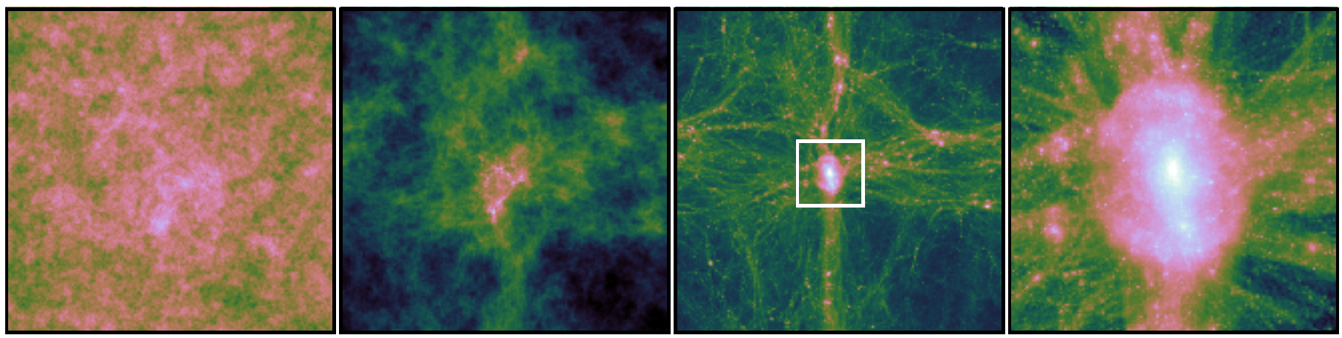
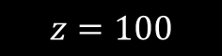

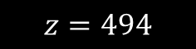
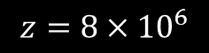
Supplemental
Flat power spectrum results
$$z=8×{10}^{6}$$
$$z=494$$
$$z=100$$
$$z=100$$

